Slide 1
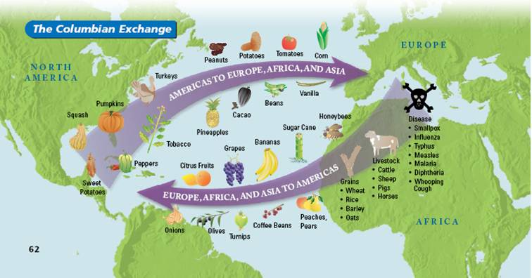
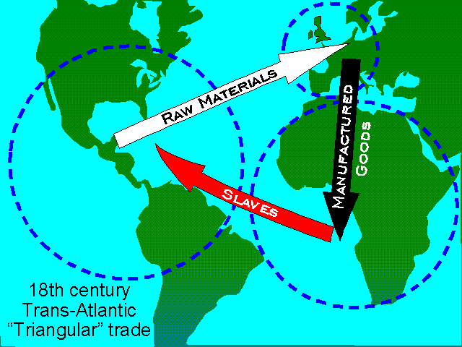
Results of Exploration
The discovery of new trade routes led to an increase in trade and an increase in the variety of trade goods.
This resulted in two new forms of trade:
Columbian Exchange and Triangular Trade
Triangular Trade

Slide 2
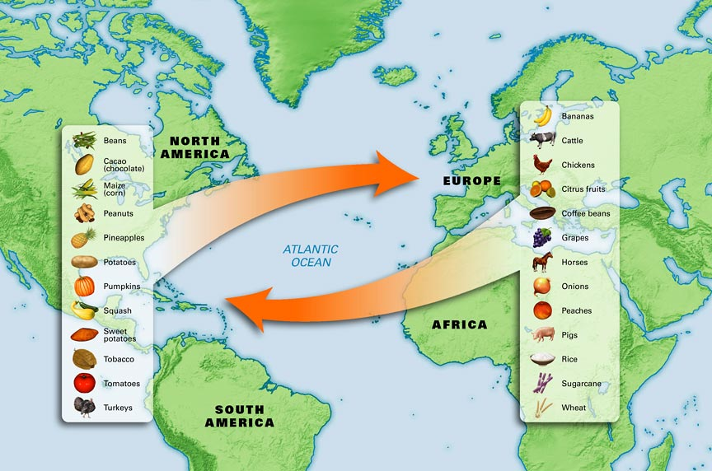
Columbian Exchange

Slide 3
Animals to the “New World”
Horse
Cow
Pig
Chicken
Rats
Bees
The introduction of beasts of burden to the Americas was a significant development from the Columbian Exchange. The introduction of the horse provided people in the Americas with a new source of labor and transportation.

Slide 4
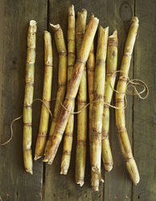
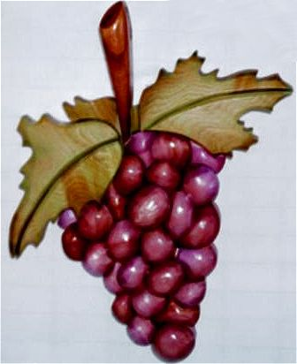
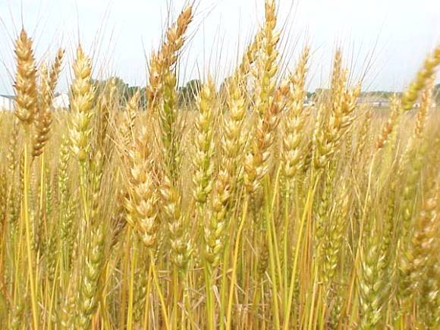
Plants to the “New World”
Sugarcane
Grapes
Wheat
Bananas
Coconut Palms
Coffee
Dandelions

Slide 5
Plants to the “Old World”
Potato
Corn
Tomato
Sweet Potato
Cacao (Cocoa)
Pineapples
Pumpkins
Until contact with Americas, Europeans had never tried tomatoes
Most Europeans thought tomatoes poisonous
By late 1600s, tomatoes had begun to be included in Italian cookbooks
Exchange of foods, animals had dramatic impact on later societies
Over time crops native to Americas became staples in diets of Europeans
Foods provided substantial nutrition, helped people live longer and European population grew

Slide 6
Effects of Columbian Exchange felt not only in Europe and the Americas
China
Arrival of easy-to-grow, nutritious corn helped population grow tremendously
Also a main consumer of silver mined in Americas
Africa
Two native crops of Americas—corn, peanuts—still among most widely grown
Scholars estimate one-third of all food crops grown in world are of American origin

Slide 7
“Old World” Diseases
“New World” Diseases
Smallpox
Measles
Diphteria
Chicken Pox
Bubonic Plague
Influenza
Cholera
Malaria
Syphillis
Hepatitis
Polio
Tuberculosis

Slide 8
The Introduction of New Diseases to the Americas
Native Americans had no natural resistance to European diseases
Smallpox, measles, influenza, malaria killed millions
Population of central Mexico may have decreased by more than 30 percent in the 10 years following first contact with Europeans
Devastating Impact
Native American population continued to decline for centuries
Inca Empire decreased from 13 million in 1492 to 2 million in 1600
North American population fell from 2 million in 1492 to 500,000 in 1900—but disease not only factor in decrease of population
Intermittent warfare, other violence also contributed

Slide 9
Long Term Causes:
God
Gold
Glory
Immediate Causes:
Europeans arrive in the Americas
Europeans bring new plants, animals and diseases to the Americas
Columbian
Exchange
Immediate Effects:
Spanish conquer Aztecs and Incas
Native Americans die of European diseases
Enslaved Africans are brought to the Americas
American foods are introduced to other parts of the world
Long Term Effects:
Spread of products all around the world
Population growth in Europe, Asia, and Africa
Cultural diffusion
Migration from Europe to the Americas
Growth of Capitalism

Slide 10
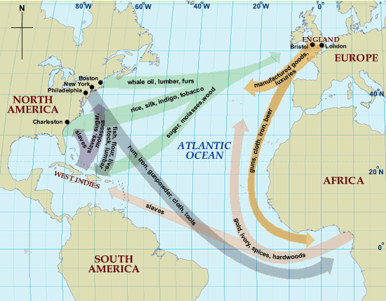
Triangular Trade

Slide 11
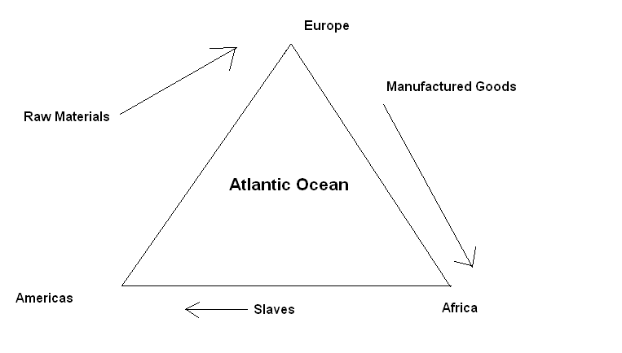
Triangular Trade

Slide 12
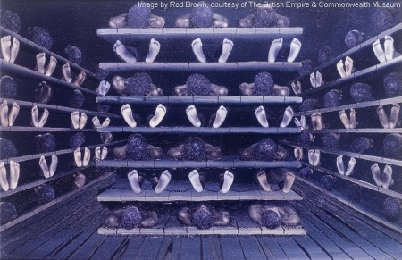
Triangular Trade
The worst part of Triangular Trade was the Middle Passage.
This was the part of the trip from Africa to the New World, as they crossed the Atlantic Ocean.
Many slaves would be packed onto ships without enough food and water. They would be chained together in cramped conditions. Many would die on the journey. Europeans did not care though because they only viewed slaves as property.

Slide 13
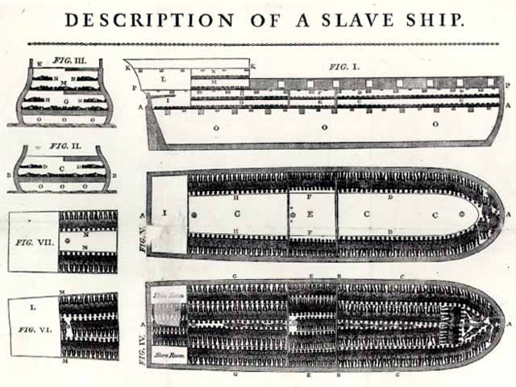
Triangular Trade

Slide 14
Trade and Economic Power
European countries saw colonies as a way to make money.
This caused MERCANTILISM to develop. This means that the government controls all economic activity in the country and colonies. Their goal is to make the country stronger and richer.
Countries used mercantilism to keep trade balanced, meaning they imported and exported an equal amount. Also they used it to find more gold and silver. These valuables were considered a measure of how great a country was.
Mercantilism included:
Building a network of overseas colonies
Forbidding colonies to trade with other nations

