Slide 1
SAQ – You can do this!
Dr. Afxendiou
Sachem North High School

Slide 2
The basics
DIRECTLY answer the question
Be EXPLICIT – be specific, do not write broad generalizations, do not be vague
Give evidence and specific information
Use the words of the question to begin your answer – it helps keep you on task
Continue with specific historical information, historical terms, events, people – prove to the reader that you know your history

Slide 3
Specifics
Responses should be 3 to 5 content rich sentences per section (a, b, and c)
Use the following format:
Your response
Your response
Your response
Letter each part and skip a line between each section

Slide 4
What should be in your answer
Relationships, causes, effects, connections
Include analysis – answer the WHY and HOW

Slide 5
Do this! A.C.E. the exam
ANSWER THE QUESTION - Directly answer the question by identifying your claim
CITE SPECIFIC EVIDENCE - people, events, specific facts
EXPLAIN / EXPAND – explain how the evidence supports your assertion; expand your answer by placing your claim within the historical context
Do this for each part of the question.

Slide 6
What NOT to do
Don’t write a short essay
Don’t write a full paragraph
Don’t write in bullet points
Don’t look for the answer in the source provided, it is only a guide, a place to start
Don’t write outside the box

Slide 7
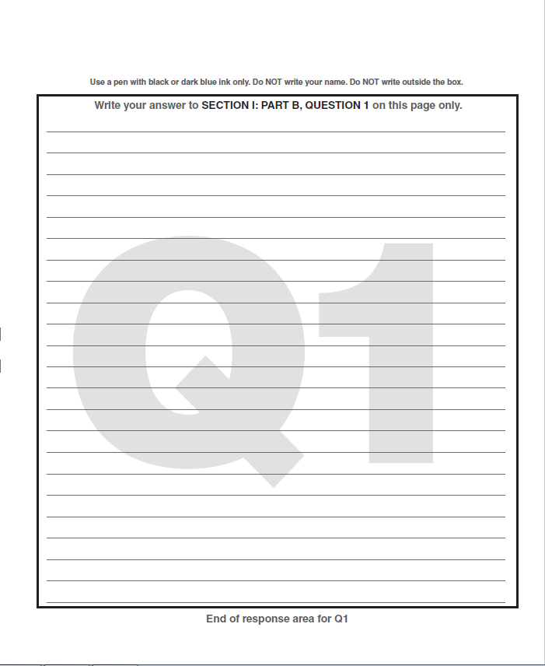

Slide 8
Let’s do this! According to the poet, why were the Zhou able to take over from the Shang as rulers?
ANSWER THE QUESTION
CITE SPECIFIC EVIDENCE
EXPLAIN / EXPAND

Slide 9
A.C.E.
A. According to the poet, the Zhou were able to replace Shang rule with a mandate from heaven because the founders of the dynasty ruled with fairness and care for the people.

Slide 10
A.C.E.
A. According to the poet, the Zhou were able to replace Shang rule with a mandate from heaven because the founders of the dynasty ruled with fairness and care for the people. According to the document, King Wen, an early ruler of the Zhou Dynasty, was bright and reverent meaning that he was respectful of his position and his people.

Slide 11
A.C.E.
A. According to the poet, the Zhou were able to replace Shang rule with a mandate from heaven because the founders of the dynasty ruled with fairness and care for the people. According to the document, King Wen, an early ruler of the Zhou Dynasty, was bright and reverent meaning that he was respectful of his position and his people. The idea of the mandate of heaven was created by Zhou to justify their overthrow of the Shang. It was the belief that rulers can only rule with the consent of heaven which consent can also be taken away. This idea had the long term consequence of the dynastic cycle.

Slide 12
Let’s do this! What implications does the idea of the “Mandate” expressed here have for future rulers?
ANSWER THE QUESTION
CITE SPECIFIC EVIDENCE
EXPLAIN / EXPAND – Define/Place your claim within the historical context

Slide 14
Let’s take it further…
C. Discuss a continuity and change in Chinese history indicated by the document.

