Slide 1
The Mongols

Slide 2
Empires Video – Mongols, Mali and Inca
http://www.learner.org/courses/worldhistory/unit_video_11-1.html?pop=yes&pid=2154#

Slide 3
Nomads of the Asian Steppe
Steppe: vast area of dry grassland
It stretches across Eurasia
It served as a land trade route
Home to nomadic people who roamed and conquered areas surrounding them.

Slide 4
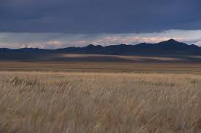

Slide 5
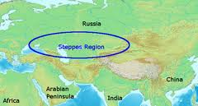

Slide 6
Nomadic Way of Life
Pastoralists: herded domesticated animals.
Constantly on the move searching for pastures to feed their herds.
Mostly traveled on horseback .
Traveled together in groups called clans.
Different clans joined together if large force was needed to attack

Slide 7
Steppe Nomads and Settled Societies
Engaged in peaceful trade most of the time
If empires were weak and divided powerful nomadic groups attacked.

Slide 8
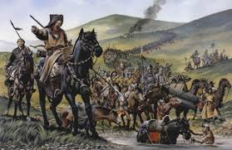
Rise of the Mongols

Slide 9
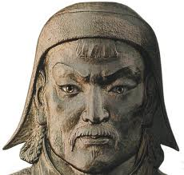
Mongols roamed loosely in organized clans.
Around 1200 military and political genius unites the Mongols – Temujin
Genghis Khan which meant “Universal Ruler” united the Mongols.
1206 – Kuriltai convenes and chooses Temujin as the KHAGAN
Kuriltai – meeting of all
Mongol leaders

Slide 10
Genghis the Conqueror
Brilliant Organizer- assembled warriors into fighting force – organized army into TUMENS
Tumens – units of 10,000 soldiers
Strategist: he used war tricks to confuse the enemy
Used cruelty and fear as a weapon: terrified enemies into surrendering.

Slide 11
Mongol Conquests
The Mongols began to conquer much of Asia
He began with China in 1211 and launched the “campaign of terror” across Central Asia.
They destroyed city after city and slaughtered many inhabitants.
1225: Central Asia was under Mongol Control
By Genghis Khan’s death in 1227, the Mongols controlled Asia from the North China sea to Persia
He made Karakorum the capital of his empire

Slide 12
He became the patron of artists and intellectuals in areas he conquered
He gathered great thinkers from many places of his empire at Karakorum
His son Ogedai was chosen by the kariltai to succeed him as the Great Khan
The Empire was divided by his sons and one of his grandsons into 4 khanates
Ogedai continued conquest and expanded the empire

Slide 13
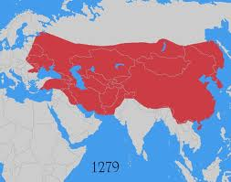

Slide 14
THE MONGOL EMPIRE

Slide 15
The Four Khanates

Slide 16
The Mongol as Rulers
Harsh warriors, but were tolerant in peace once land was conquered.
Did not impose their beliefs or way of life on conquered people.
Adopted cultures of some of the people they ruled.
Pax Mongolica: 1200s-1300s period of peace, stability and law and order across Eurasia
- allowed for the safe passage of trade, travelers and missionaries.
Merchants were the greatest beneficiaries of the peace

Slide 17
Khanate of the Golden Horde
One of the four divisions of Genghis Khan’s empire
Its goal was to conquer Europe
Conquered almost all of Russia and reached Hungary
Mongols allowed Russians to practice their religion and culture
Effects of Mongol rule on Russia:
Led to the rise of autocratic rulers
Separated Russia from the rest of Europe so that it did not share a common history with western European countries

Slide 18
Mongols in China
Kublai Khan – grandson of Genghis Khan conquers China and ends the Song Dynasty
He sets up the Yuan Dynasty
He becomes the next Great Khan
Only time in Chinese history that it is ruled by foreigners
Chinese and Mongol cultures are kept separate and intermarriage is forbidden
It was during Kublai Khan’s rule that Marco Polo visited China

Slide 19
Mongols in China
Yuan dynasty ended with the death of Kublai Khan
Chinese always resented foreign rule
Mongol rule was weakened after two failed attempts to conquer Japan – maybe Heaven did not favor them?
Secret sects cause instability
Replaced by the Ming Dynasty

