Slide 1
The Russian Empire
Dr. Afxendiou
AP World History 9
Sachem North High School

Slide 2
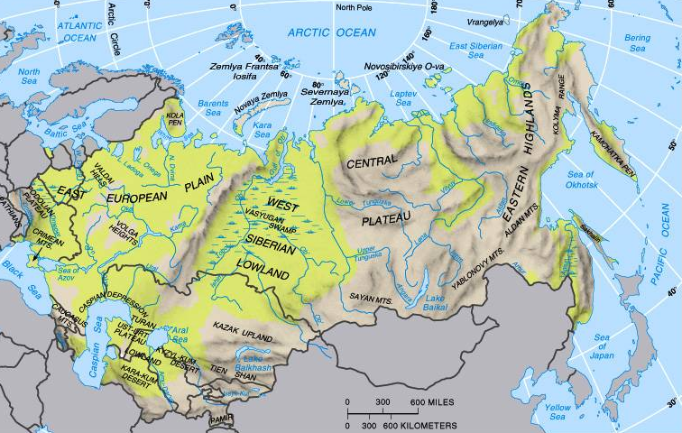
Russian Geography
Primary characteristic – NEVER FORGET… NO WARM WATER PORTS!

Slide 3
History of Russia (PARTS 1-5) - Rurik to Revolution
https://www.youtube.com/watch?v=w0Wmc8C0Eq0

Slide 4
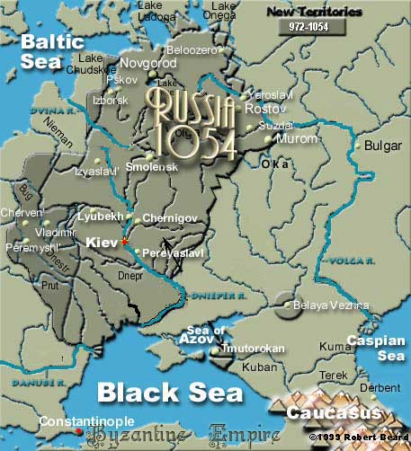
Early Russian history (Review)
Mix of Slavic tribes and Vikings
Kiev the first major city (today in Ukraine)
First Slavic state called Kievan Rus
Engaged in trade with Constantinople
Heavily influenced by Byzantine Empire
Prince Vladimir converted Russian people to Orthodox Christianity
Eventually adapt the Cyrillic alphabet

Slide 5
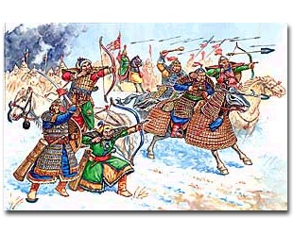
Russian History
Kiev declined because of poor leadership.
The Mongols took advantage of Kiev's weakness.
By 1240AD they had conquered every city in Kievan Rus
Russia conquered by the Golden Horde
The Mongols taxed the people heavily
Russians were able to keep their own government and customs
Princes were allowed to remain in power

Slide 6
Effects of Mongol rule
Mongols left Russia weak and isolated in connections, especially with Western Europe.
Mongols reduced vitality of Russian culture.
Economic life was slow.
Trade was down, limited manufacturing
Purely an agricultural economy reliant on peasant labor

Slide 7
The Grand Duchy of Moscow
Led the opposition against the Mongols
1480 Russia liberated from Mongol rule by Ivan III

Slide 8
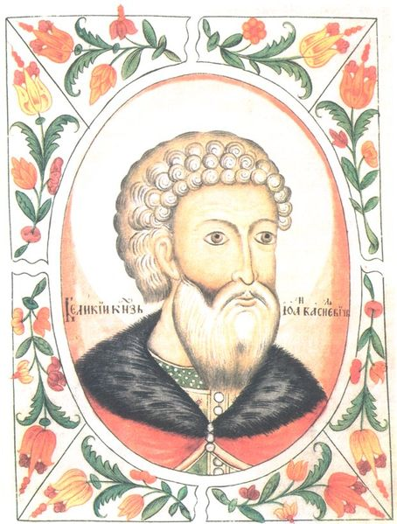
Ivan III, 1462-1505
Known as Ivan the Great
Freed Russians from Mongol rule in 1480
Laid foundations of Russian national state
Restored centralized rule - proclaimed his absolute sovereignty over all Russian princes and nobles
forced lesser princes to accept him and his successors as unquestioned rulers over military, judicial, and foreign affairs
After the fall of the Byzantine Empire he claimed that Russia succeeded them as the “Third Rome” and seat of Orthodox Christianity
Moved capital to Moscow
Sent diplomatic missions to western countries

Slide 9
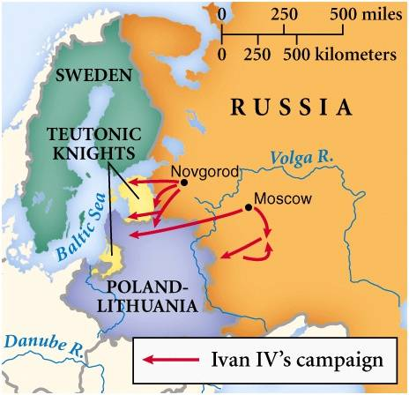
Ivan IV 1533-1547 Grand Prince of Moscow 1547-1584 Czar
Continued policy of expansion begun under Ivan III
Established absolute monarchy with himself as czar (tsar)
Subordination of boyars – nobles - exiling many, and executing many to establish his authority – thus the name Ivan the Terrible
Established secret police
Established trading contacts with the west

Slide 10
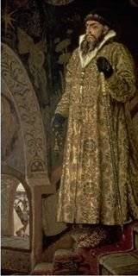
Ivan IV 1533-1547 Grand Prince of Moscow 1547-1584 Czar
complex personality; described as intelligent and devout, yet given to rages and prone to episodic outbreaks of mental illness.
One notable outburst may have resulted in the death of his groomed and chosen heir Ivan Ivanovich, which led to the passing of the Tsardom to the younger son the weak and possibly intellectually disabled Feodor

Slide 11
Russian Expansion
Recruited Cossacks (Russian peasant pioneers/military) to aid expansion.
Took over sparsely populated regions
Expansion leads to addition of Muslims in Central Asia to Russian territory – Russia becomes a multicultural state
Expansion offered rewards - Tsars gave nobles and bureaucrats estates on new land
Central Asian nomads restricted by expansion of Russian and Ottoman Empires

Slide 12
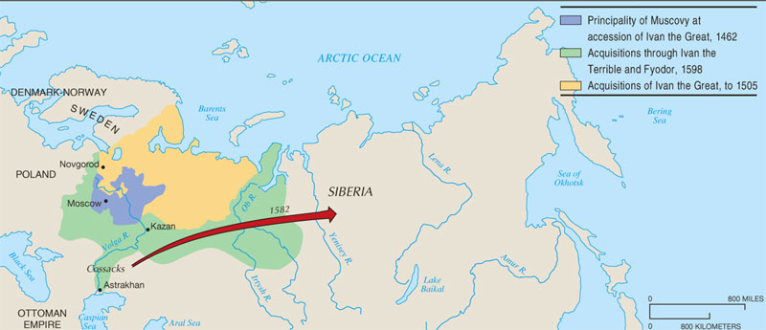
Russian Expansion Under the Early Tsars
From its base in the Moscow region, Russia expanded in three directions (N; W; S); the move into Siberia under Ivan the Terrible involved pioneering new settlements, as the government encouraged Russians to push eastward.

Slide 13
Questions:
What is an accomplishment of Ivan III?
What is an accomplishment of Ivan IV?
Who are the Cossacks and how did they affect Russian history?

Slide 14
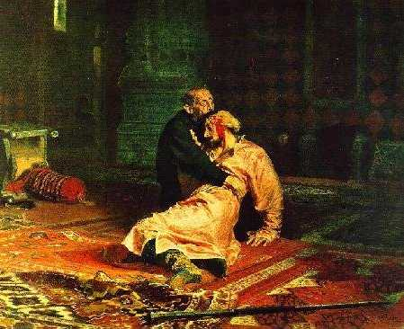
Time of Troubles
Ivan IV died without an heir.
New claims to power by boyars.
Weakness leads to attacks from Sweden and Poland.
Anarchy
Rebellion
Civil war
6 different czars

Slide 15
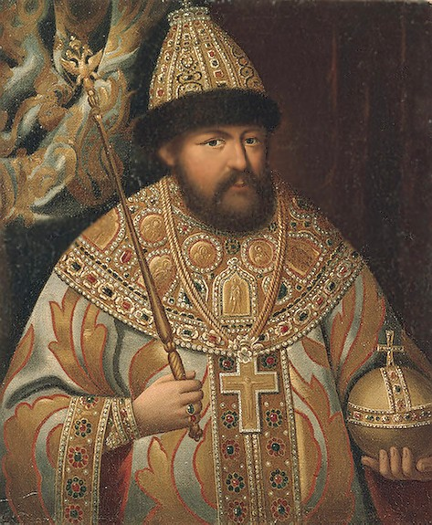
Romanov Dynasty 1613-1917
Mikhail Romanov (1st Romanov) – chosen by the boyars - reestablished internal order.
Drove out invaders.
Expanded borders up to Ottoman Empire
Alexis Romanov (2nd Romanov)
Increased authority of the czar by abolishing the assemblies of nobles
Put state in control of Russian Orthodox Church.
Cleansed church of rituals that developed during Mongol rule
Exiled those who resisted, the “old believers” to Siberia and Southern Russia

Slide 16
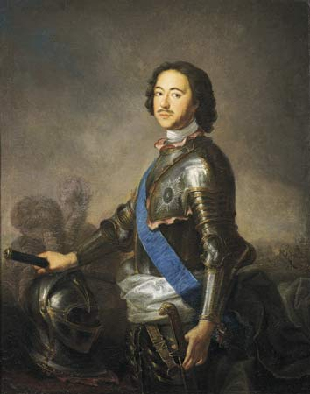
Peter the Great’s Westernization
Opens Russia up to Western influence
Improvements in political organization
Specialization of Russian bureaucracy
Revision of law codes
Improved weaponry
Revised tax system
Bureaucracy and the military reorganized on western principles
First Russian navy created
Reinforced authoritarian rule – rejected parliamentary system he saw in Europe

Slide 17
Peter the Great’s Westernization
Economic developments (inherited a Russia that was largely agricultural)
Built up mining industries so Russia will not need to import metal for weapons
Used Western technology knowledge
Landlords rewarded for using a serf system in manufacturing

Slide 18
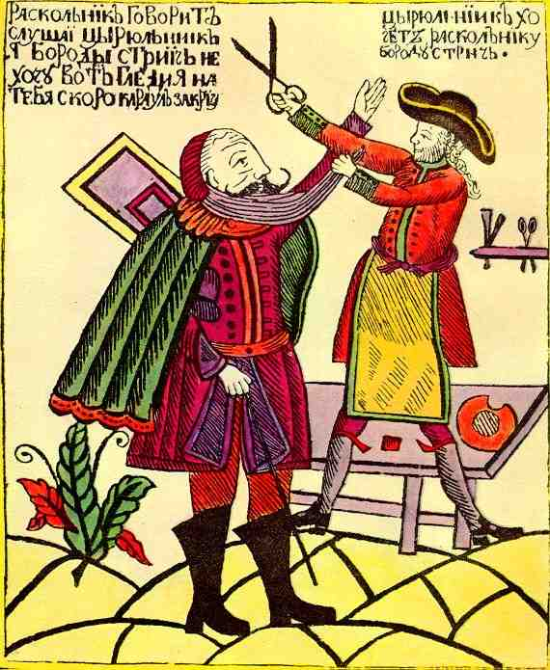
Peter the Great’s Westernization
Cultural change from his trips to Western Europe
Brought Western science, technology, ballet, gender attitudes
Nobles had to shave beards and dress in western style clothes
Limited to the elite; no wide-spread cultural change
Promoted education in mathematics and technical subjects
Position of upper class women improved
Expanded territory - Largest state in the world from Baltic to Pacific Ocean
New capital – St. Petersburg “Window to the West”

Slide 19
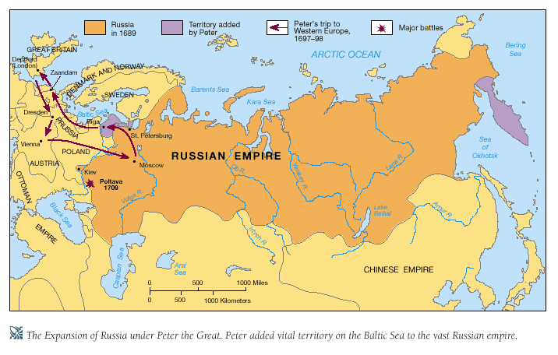
Russia Under Peter the Great
From 1696 to 1725, Peter the Great allowed his country only one year of peace. For the rest of this reign he pursued war. By the end, he had established territory on the southern shores of the Baltic Sea, where he founded the new city of St. Petersburg.

Slide 20
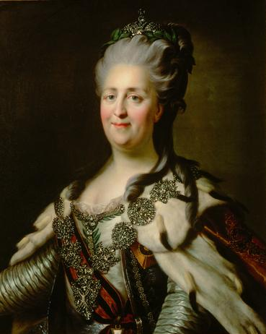
Catherine the Great
Peter the Great died in 1724
Several decades of weak rule
Peter III took the throne in 1761; he was assassinated and his wife Catherine II rules
Catherine II (Catherine the Great) (reigned 1762-1796)
Defender of monarchical powers; strict interpretation of absolute monarchy
Continues expansionist trends and westernization of Peter the Great
Interested in Enlightenment – up until the French Revolution

Slide 21
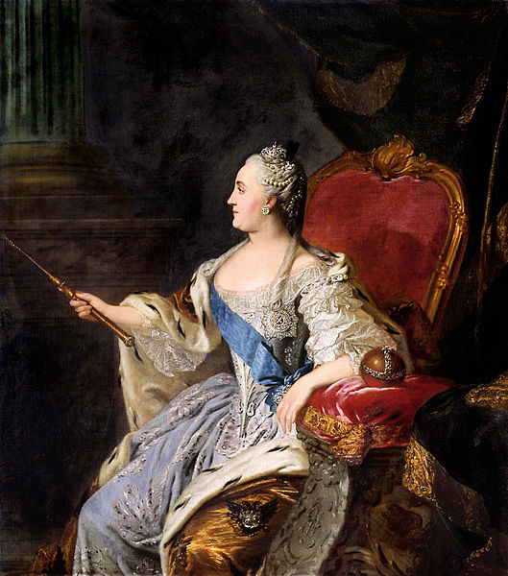
Catherine the Great
Supported boyars: gave them new powers over serfs and their estates in exchange for their services in the bureaucracy and the military
Pugachev Rebellion (1773-1775)
Used it as an excuse to gain greater military and judicial powers
Selective Westernization
Patronized Western-style art and architecture
By 1798, Russia had the largest land empire in the world and is one of the great powers of Europe.

Slide 22
Compare Iberian expansion and Russian expansion

Slide 23
Compare Iberian expansion and Russian expansion
Differences:
Iberian maritime expansion, Russian over land expansion
Cultural impact of the West: Russian rulers decided which elements of western culture they wanted to adapt, in Latin America it was simply imposed.
Similarities:
Development of systems of coerced labor
Adapted western culture

